Slide 1

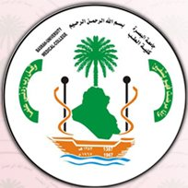
Motor System
Dr. Massara Ghassan Abdulkareem
Physiology Department
College of Medicine\ University of Basrah

Slide 2
Lecture 3 motor cortex
Objectives
What is motor cortex
Main Motor cortex areas
Some specialized areas of motor cortex.

Slide 3
The motor cortex is the region of the cerebral cortex involved in the planning, control, and execution of voluntary movements.
University of Basrah-College of Medicine-Physiology Department

Slide 4
Motor Cortex
Anterior to the central cortical sulcus, occupying approximately the posterior one third of the frontal lobes,
It divided in to 3 Areas:
primary motor cortex
premotor area
supplementary motor area
University of Basrah-College of Medicine-Physiology Department

Slide 5
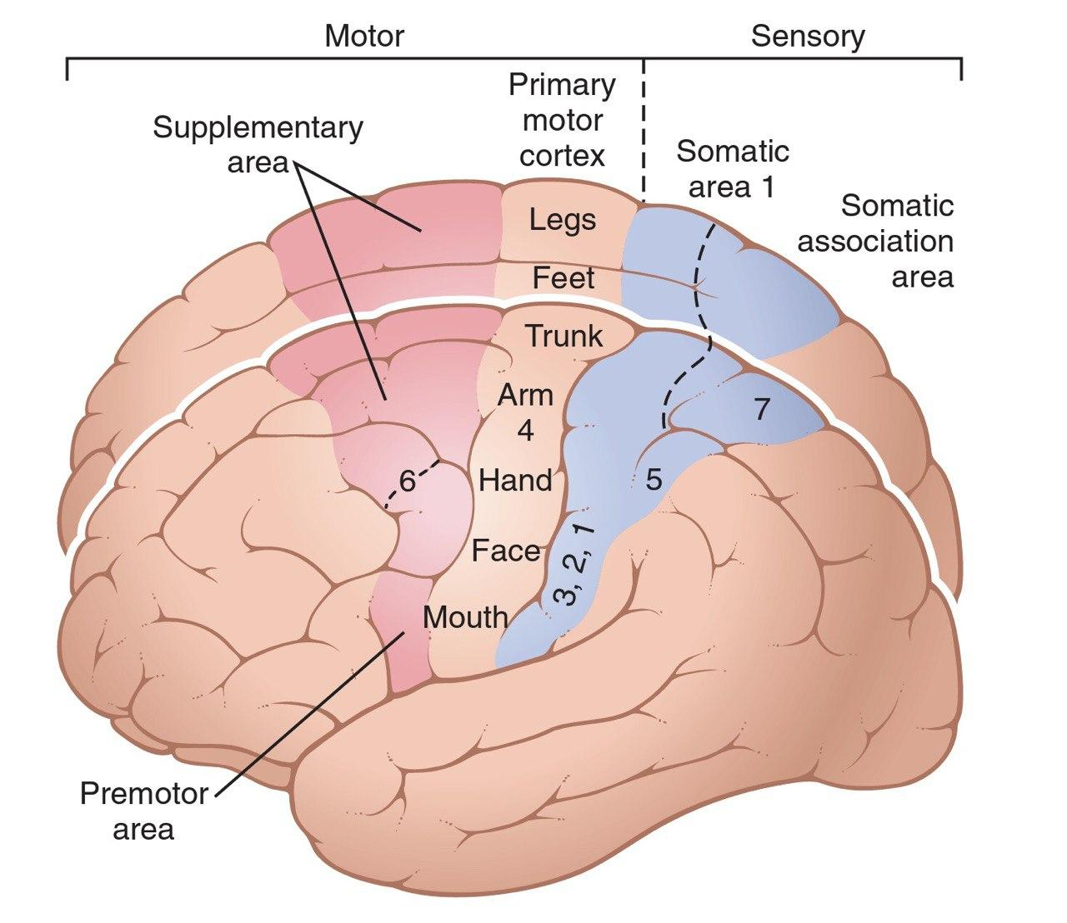
University of Basrah-College of Medicine-Physiology Department

Slide 6
Each has its own topographical representation of muscle groups and specific motor functions of the body.
University of Basrah-College of Medicine-Physiology Department

Slide 7
PRIMARY MOTOR CORTEX
lies in the first convolution of the frontal lobes anterior to the central sulcus
topographical representations of the different muscle areas of the body in the primary motor cortex
University of Basrah-College of Medicine-Physiology Department

Slide 8
University of Basrah-College of Medicine-Physiology Department

Slide 9
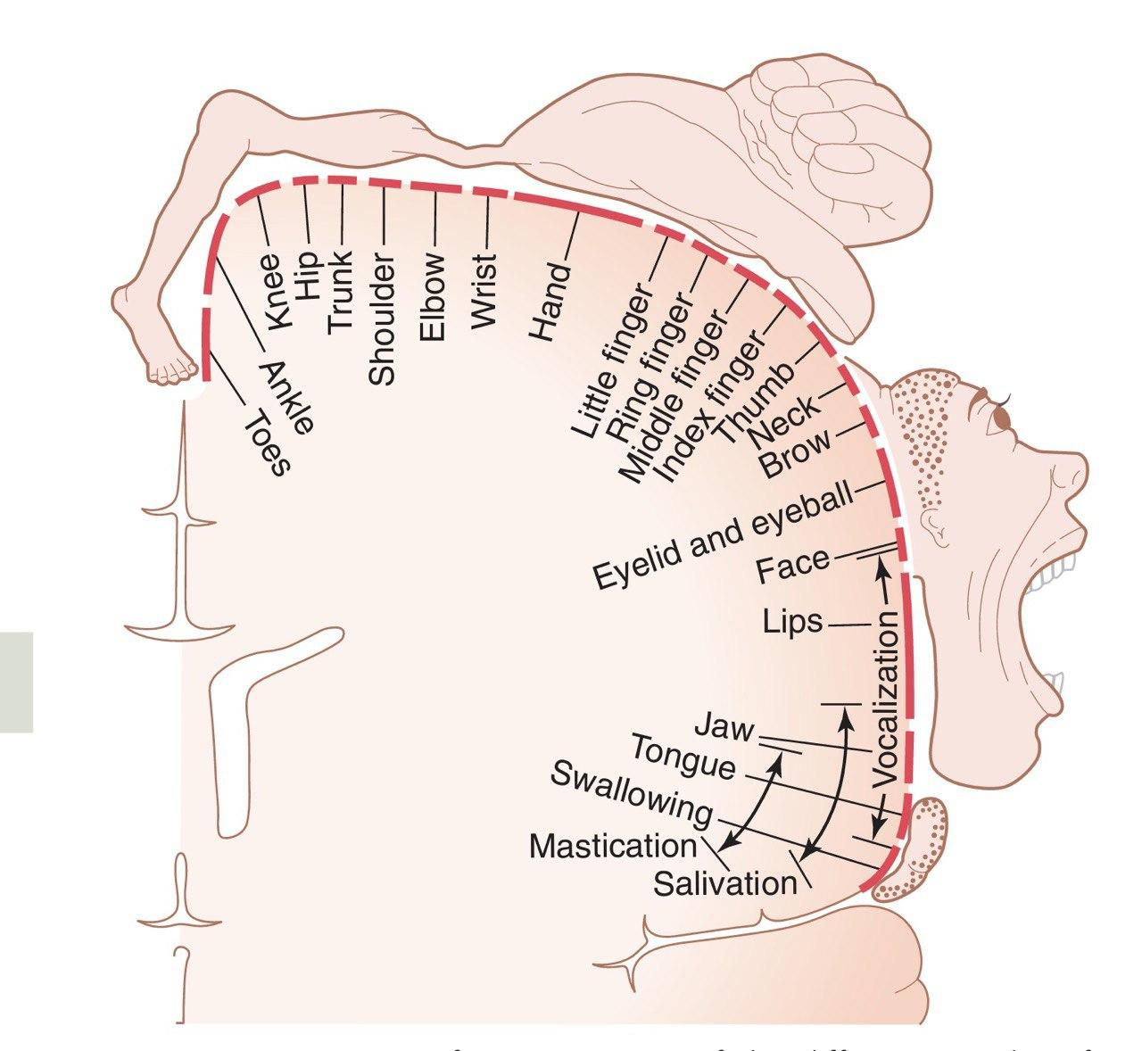
University of Basrah-College of Medicine-Physiology Department

Slide 10
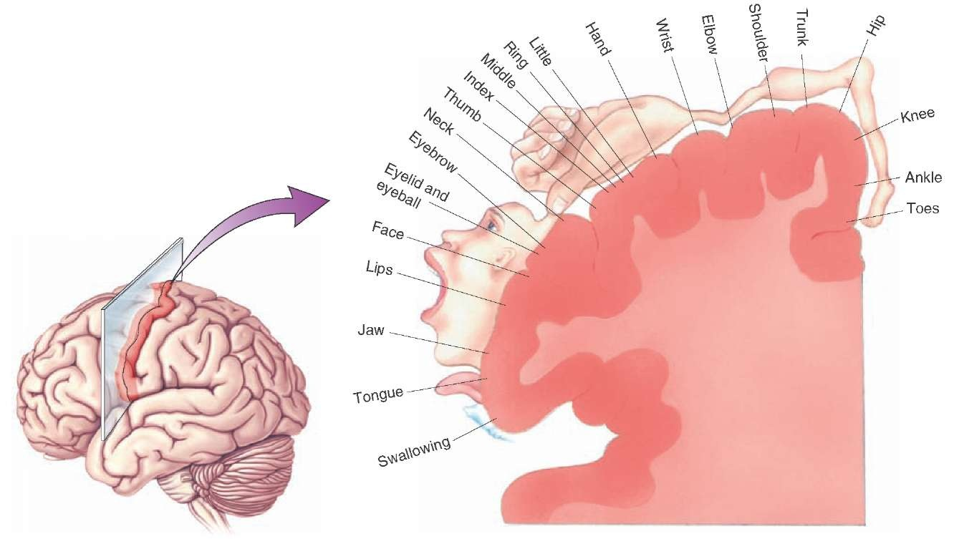
University of Basrah-College of Medicine-Physiology Department

Slide 11
Note that more than one half of the entire primary motor cortex is concerned with controlling the muscles of the hands and the muscles of speech.
excitation of a single motor cortex neuron usually excites a specific movement rather than one specific muscle.
University of Basrah-College of Medicine-Physiology Department

Slide 12
PREMOTOR AREA
lies 1 to 3 centimeters anterior to the primary motor cortex.
University of Basrah-College of Medicine-Physiology Department

Slide 13
University of Basrah-College of Medicine-Physiology Department

Slide 14
The topographical organization of the premotor cortex is roughly the same as that of the primary motor cortex, with the mouth and face areas located most laterally.
University of Basrah-College of Medicine-Physiology Department

Slide 15
Nerve signals generated in the premotor area cause much more complex “patterns” of movement than the that generated in the primary motor cortex.
For instance, the pattern may be to position the shoulders and arms so that the hands are properly oriented to perform specific tasks.
University of Basrah-College of Medicine-Physiology Department

Slide 16
SUPPLEMENTARY MOTOR AREA
It extends a few centimeters onto the superior frontal cortex.
The supplementary motor area has yet another topographical organization for the control of motor function.
University of Basrah-College of Medicine-Physiology Department

Slide 17
University of Basrah-College of Medicine-Physiology Department

Slide 18
.this area functions in concert with the premotor area to provide body-wide attitudinal movements, fixation movements of the different segments of the body, positional movements of the head and eyes.
University of Basrah-College of Medicine-Physiology Department

Slide 19
SOME SPECIALIZED AREAS OF MOTOR CONTROL FOUND IN THE HUMAN MOTOR CORTEX
control specific motor functions.
University of Basrah-College of Medicine-Physiology Department

Slide 20
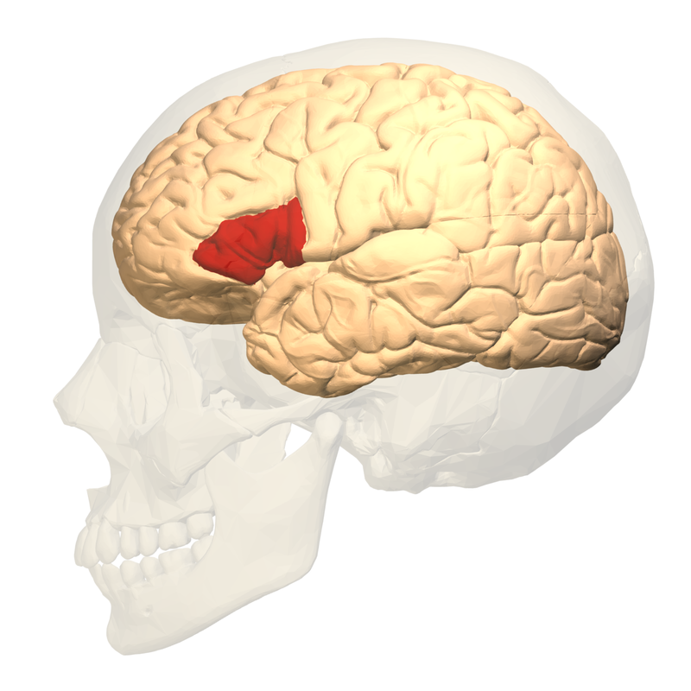
Broca’s Area (Motor Speech Area)
  It’s the site for expression of words by exciting
  simultaneously the laryngeal muscle, respiratory muscles and muscles of the mouth.
  Damage to this area → motor aphasia
  Damage to this area does not prevent a person from vocalizing, but it does make it impossible for the person to speak whole words.
University of Basrah-College of Medicine-Physiology Department

Slide 21
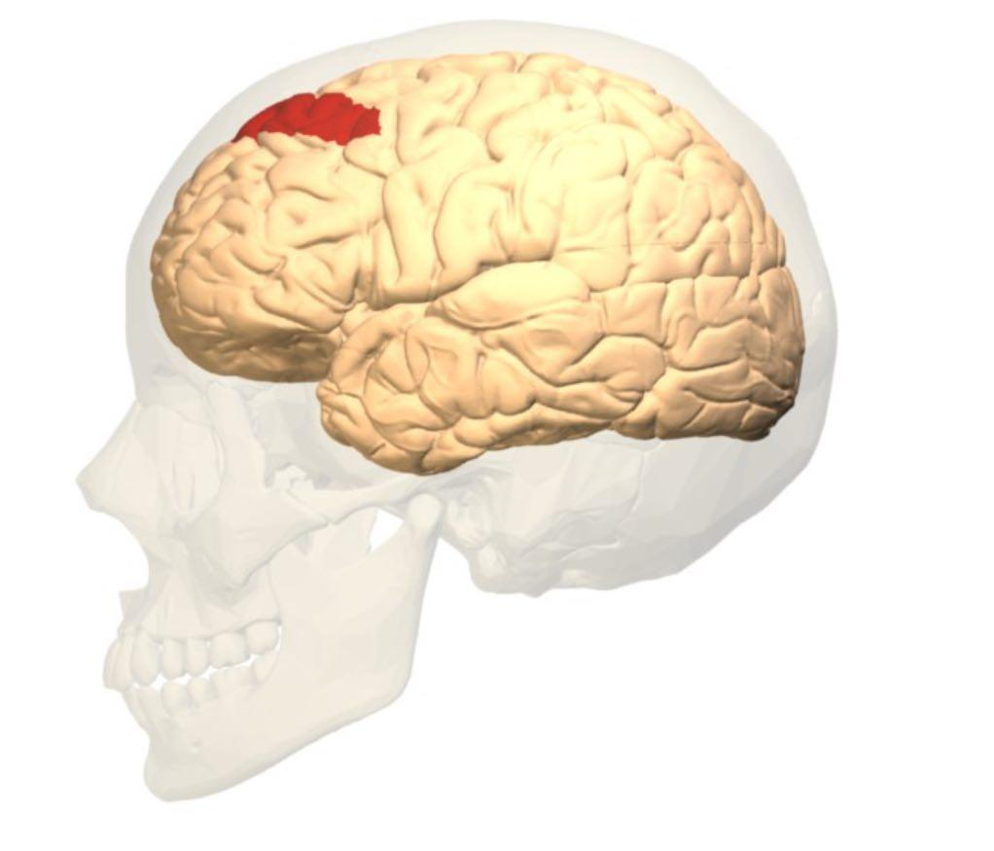
Voluntary” Eye Movement Field
  In the premotor area immediately above Broca’s area
a locus for controlling voluntary eye movements.
  Damage to this area prevents a person from
  voluntarily moving the eyes toward different objects.
University of Basrah-College of Medicine-Physiology Department

Slide 22
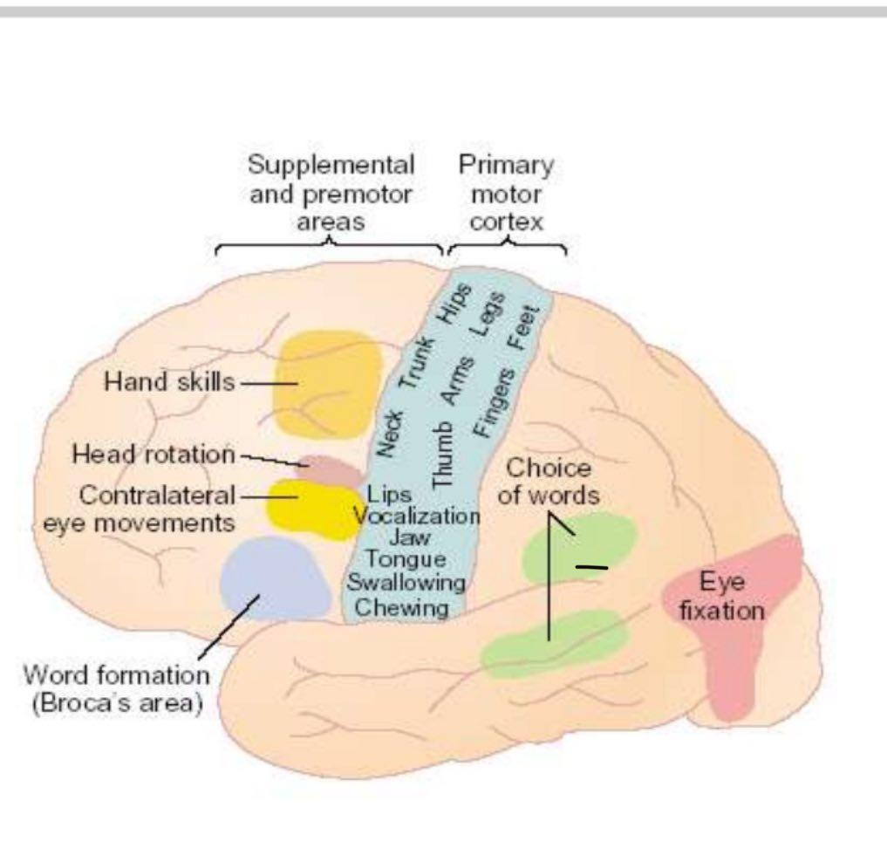
Head rotation area
Its closely associated with eye movement field and related to directing the head toward different objects.
University of Basrah-College of Medicine-Physiology Department

Slide 23
Area for hand skills
In the premotor area .
Is a region that is important for “hand skills.”
lesions cause destruction in this area, hand movements become uncoordinated and non purposeful,
a condition called motor apraxia
University of Basrah-College of Medicine-Physiology Department

Slide 24
Recap
Motor cortex: Anterior to the central cortical sulcus, occupying approximately the posterior one third of the frontal lobes.
PRIMARY MOTOR CORTEX,
PREMOTOR AREA
SUPPLEMENTARY MOTOR AREA
Broca’s Area (Motor Speech Area): expression of words.
Voluntary” Eye Movement Field: controlling voluntary eye movements.
Head rotation area: eye movement field and related to directing the head.
Area for hand skills( control hand movement).

Slide 25
Lecture 4 transmission of motor signals
Objectives
Direct: Pyramidal pathway.
Pyramidal pathway fibers.
The pathway from motor cortex down to muscle.
Indirect : extrapyramidal tract : Red nucleus

Slide 26
Motor signals are transmitted
Directly from the cortex to the spinal cord through the corticospinal tract (Pyramidal)
Indirectly through multiple accessory pathways that involve
the basal ganglia, cerebellum, and various nuclei of the brain stem ( Extrapyramidal)
University of Basrah-College of Medicine-Physiology Department

Slide 27
Corticospinal (Pyramidal) Tract
The most important output pathway from the motor cortex
Its originates about:
30 percent from the primary motor cortex
30 percent from the premotor and supplementary motor areas
and 40 percent from the somatosensory areas posterior to the central sulcus.
University of Basrah-College of Medicine-Physiology Department

Slide 28
Pyramidal tract fibers
Large fibers (3%)
16 μm in diameter
originating from Betz cells
Faster conduction (70m/sec)
Ends directly in the α motor neuron
Other fibers (97%)
4μm in diameter
Slower conduction
Synapse with interneurons which in turn synapse with α or γ motor neuron.
University of Basrah-College of Medicine-Physiology Department

Slide 29
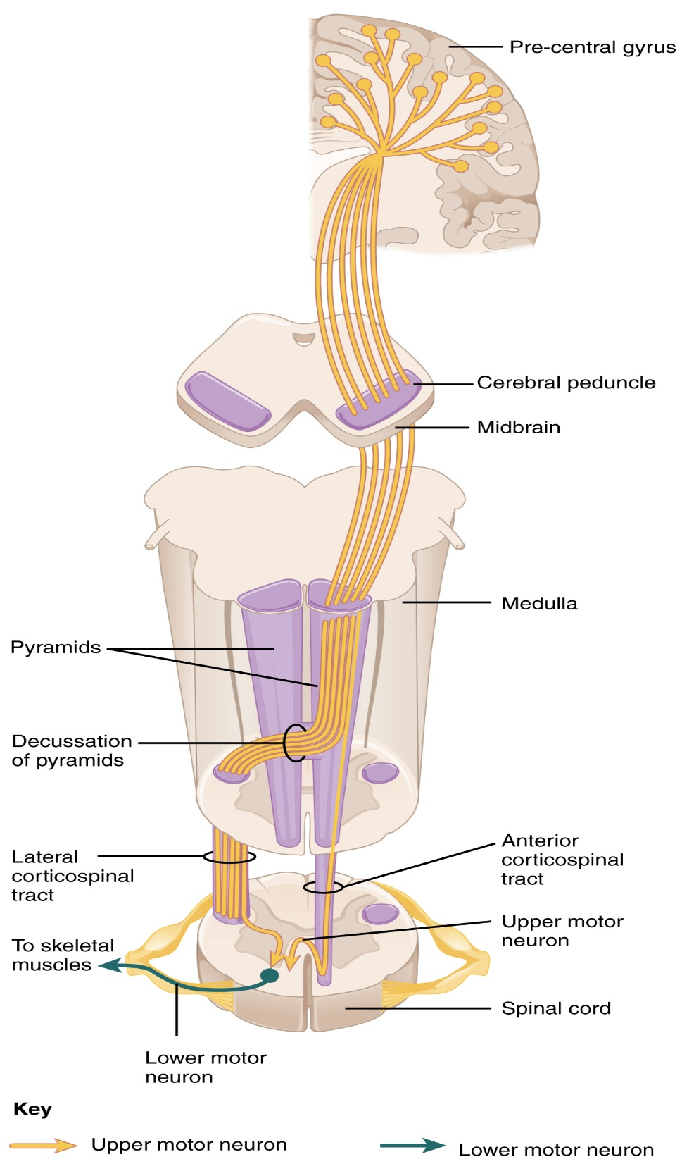
University of Basrah-College of Medicine-Physiology Department

Slide 30
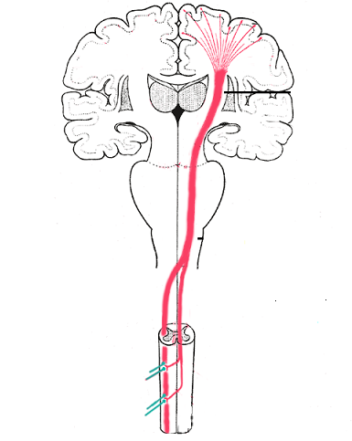
The majority of the pyramidal fibers then cross in the lower medulla to the opposite side and descend into the lateral corticospinal tracts of the cord, finally terminating principally on the interneurons in the intermediate regions of the cord gray matter
University of Basrah-College of Medicine-Physiology Department

Slide 31
A few of the fibers do not cross to the opposite side in the medulla but pass ipsilaterally down the cord in the (ventral or anterior corticospinal tracts.)
Many, if not most, of these fibers eventually cross to the opposite side of the cord either in the neck or in the upper thoracic region.
University of Basrah-College of Medicine-Physiology Department

Slide 32
“Extrapyramidal” System
  _All descending tracts other than the pyramidal tract called extrapyramidal tracts
  _Pyramidal and extrapyramidal tracts should function together for smooth activity
  _Background tone, posture, equilibrium etc., are maintained by extrapyramidal system
  _Voluntary activity is controlled by pyramidal system
University of Basrah-College of Medicine-Physiology Department

Slide 33
  Extrapyramidal fibers arise from
  1. Cerebral cortex
University of Basrah-College of Medicine-Physiology Department

Slide 34
  2. Subcortical structures
And others like tectal nucleus and olivary nucleus
Basal Ganglia
Reticular formation of brain stem
vestibular nuclei
Red
Nucleus
University of Basrah-College of Medicine-Physiology Department

Slide 35
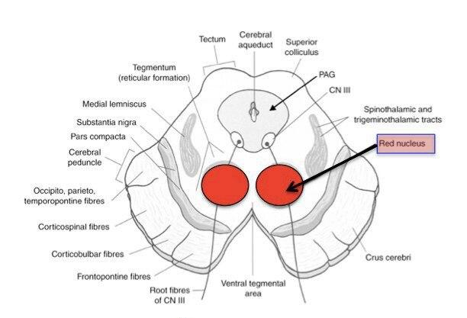
Red Nucleus
University of Basrah-College of Medicine-Physiology Department

Slide 36
THE RED NUCLEUS
Structure in the rostral midbrain involved in motor coordination
SERVES AS AN
ALTERNATIVE PATHWAY FOR
TRANSMITTING CORTICAL SIGNALS
TO THE SPINAL CORD
University of Basrah-College of Medicine-Physiology Department

Slide 37
Corticorubrospinal
  Fibers from primary motor cortex synapse with large neurons in magnocellular portion of red nuceus → corticorubral tract
  Fibers from red nucleus to spinal cord → rubrospinal tract
Which crosses to the opposite side in the lower brain stem and follows a course immediately adjacent and anterior to the corticospinal tract .
University of Basrah-College of Medicine-Physiology Department

Slide 38
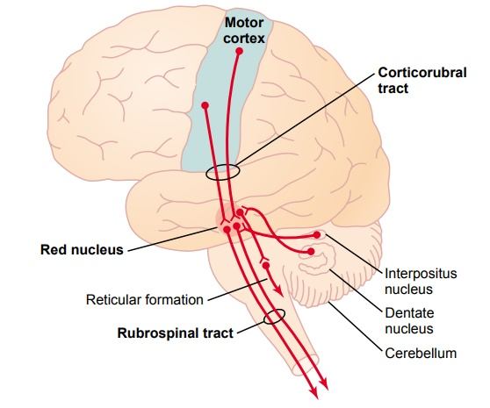
University of Basrah-College of Medicine-Physiology Department

Slide 39
Functions of Corticorubrospinal tract
  It has a representation of all the muscles of the body, as is true of the motor cortex.
  The representation of the different muscles is far less developed than in the motor cortex (it is relatively small in human beings)
  The corticorubrospinal pathway serves as an accessory route for transmission of signals from the motor cortex to the spinal cord.
University of Basrah-College of Medicine-Physiology Department

Slide 40
  When the corticospinal fibers are destroyed but the corticorubrospinal pathway is intact,
  discrete movements can still occur, except that the
  movements for fine control of the fingers and hands
  are considerably impaired.
University of Basrah-College of Medicine-Physiology Department

Slide 41
Recap
1. Pathways of motor transmission : direct Pyramidal and indirect Extrapyramidal .
2.corticospinal tract :The majority will cross in the lower medulla to the opposite side and descend into the lateral corticospinal tracts of the cord, terminating on the interneurons in the intermediate regions of the cord gray matter.
few of the fibers do not cross to the opposite side in the medulla but pass ipsilaterally down the cord in the (ventral or anterior corticospinal tracts.)
3. Red nucleus: Structure in the rostral midbrain involved in motor coordination, transmission of discrete signals from the motor cortex to the spinal cord.

